Slide 1
Pharma Store Management System

Slide 2
INTRODUCTION TO PROJECT
The web based “PHARMA STORE MANAGEMENT SYSTEM” project is an attempt to simulate the basic concepts of pharmacy inventory management system.

Slide 3
Purpose
Purpose of Pharmacy store management system project is that the system will be used to fulfill the need of tracking medicines online and to make sure the necessary stock is available for required medicines

Slide 4
scope
Pharma store management system is web-based application that allows the admin to handle all the activities online quickly.
So, the aim of the project is to track products.
The Admin can keep track of the products from list of available medicines and restock the items as well as add new items to the list

Slide 5
Module
Admin module

Slide 6
Admin module
Sub Module
- View products
- Add remove items
- View stock details

Slide 7
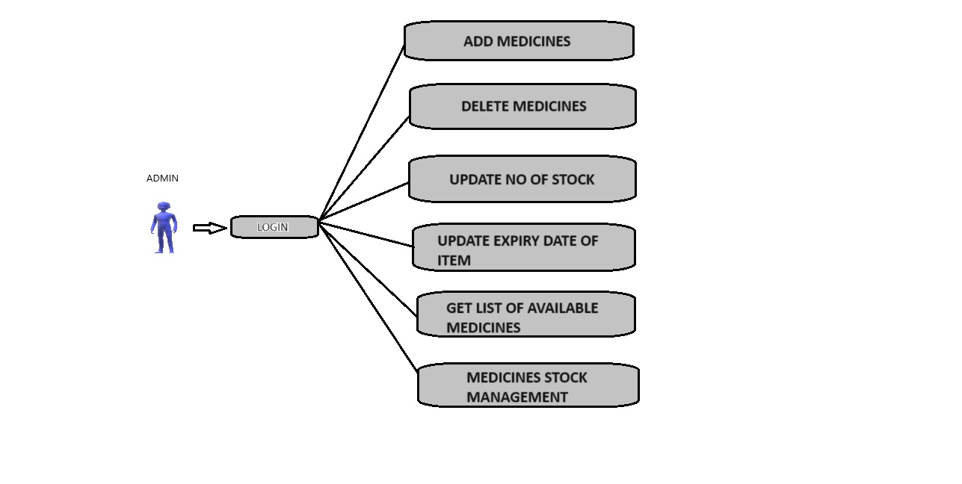
USE CASE DIAGRAM

Slide 8
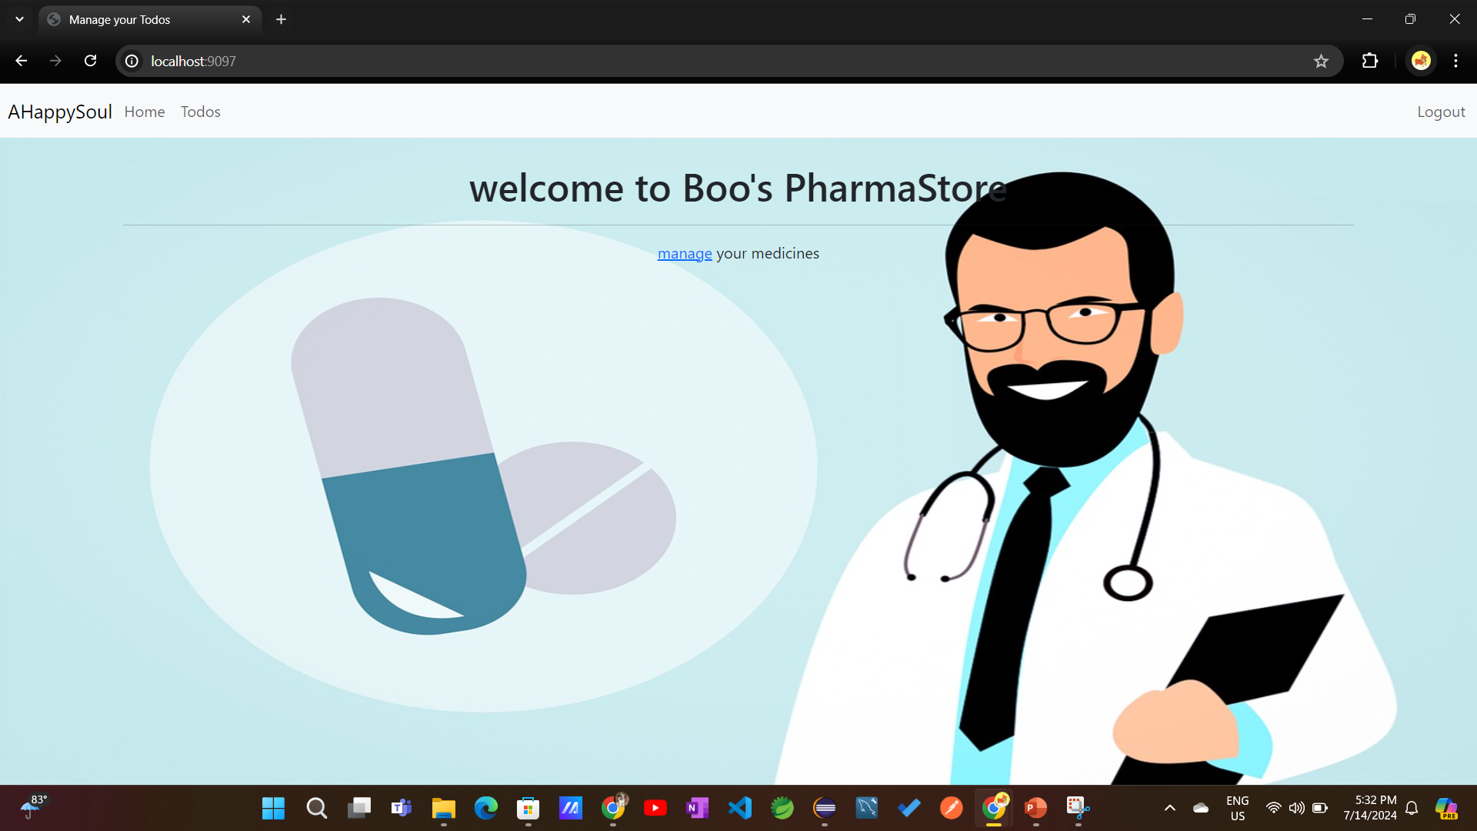
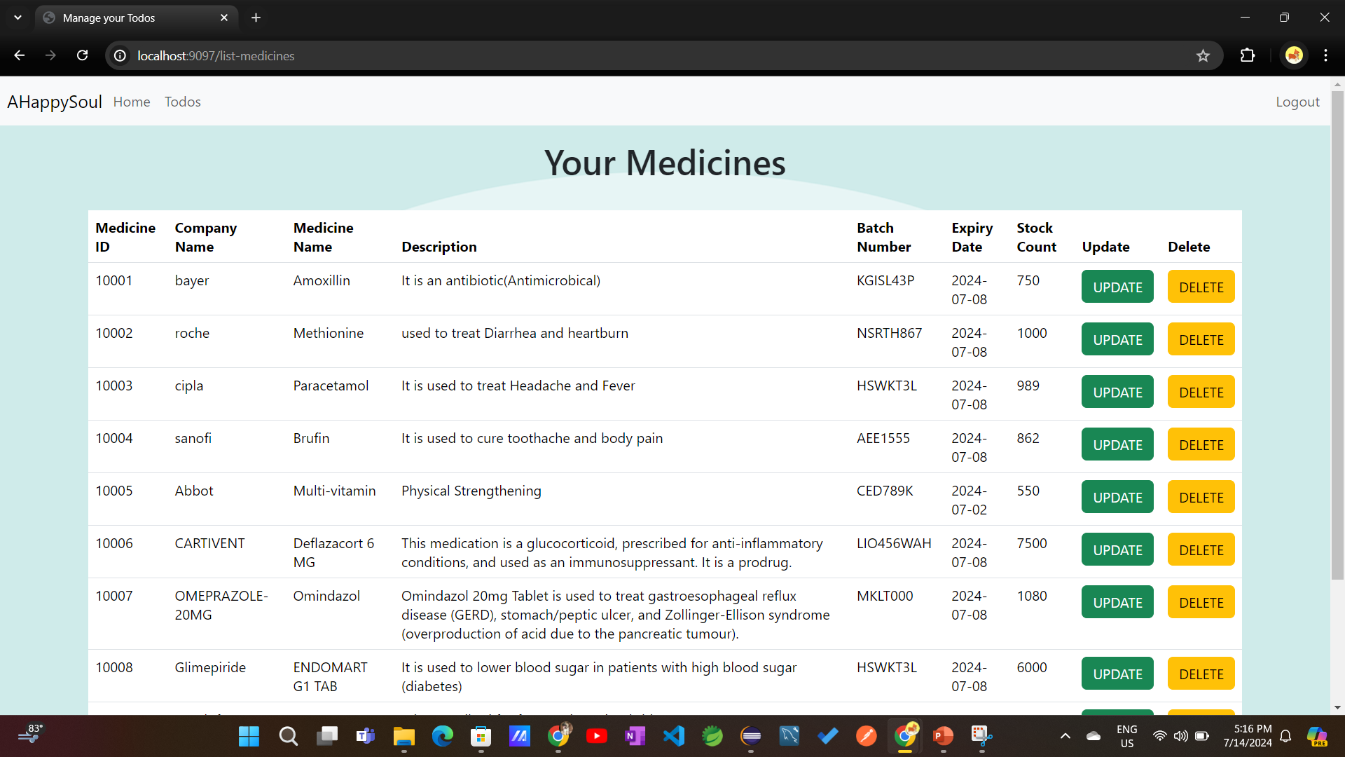
PROJECT SCREENSHOTS
Home page
View Medicine Details

Slide 9
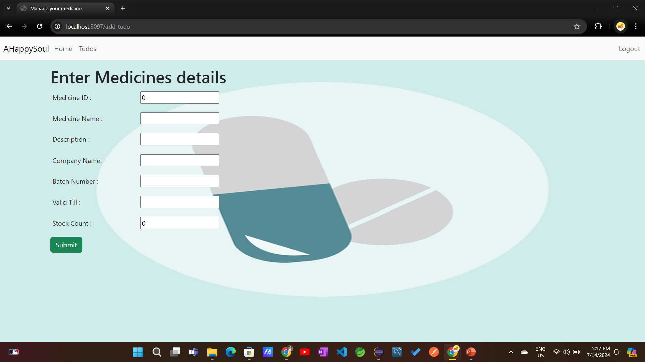
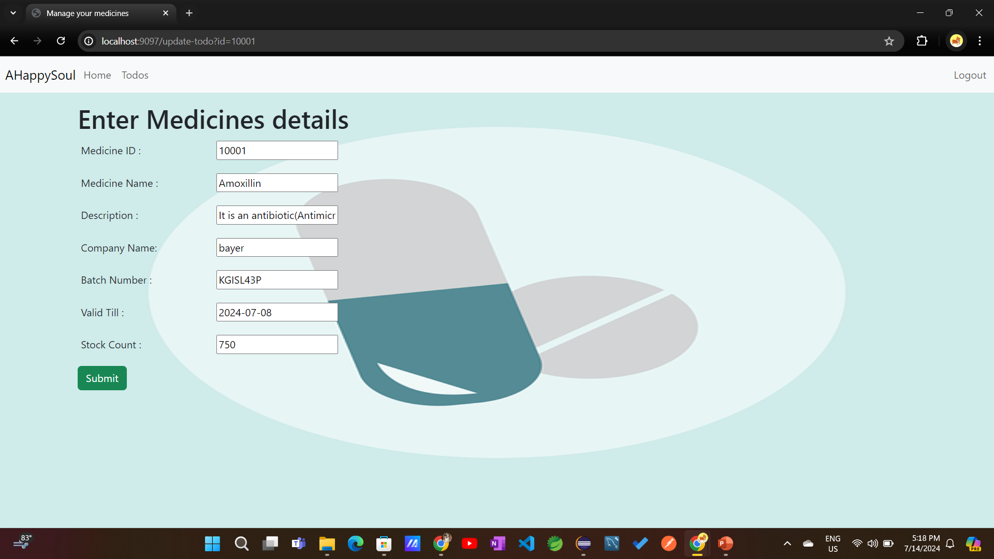
Add a new Medicine to the Store
Update stock or other details for a medicine

Slide 10
Launching Swagger UI
Swagger UI Is available at Http://localhost:9097/swagger-ui.html
Below screenshot shows the Home Page of Swagger UI. It shows a list of all the resources that are exposed.
It shows all the request methods that can be used with a Resource.
You can also see the details for a Specific Request Method.

Slide 11
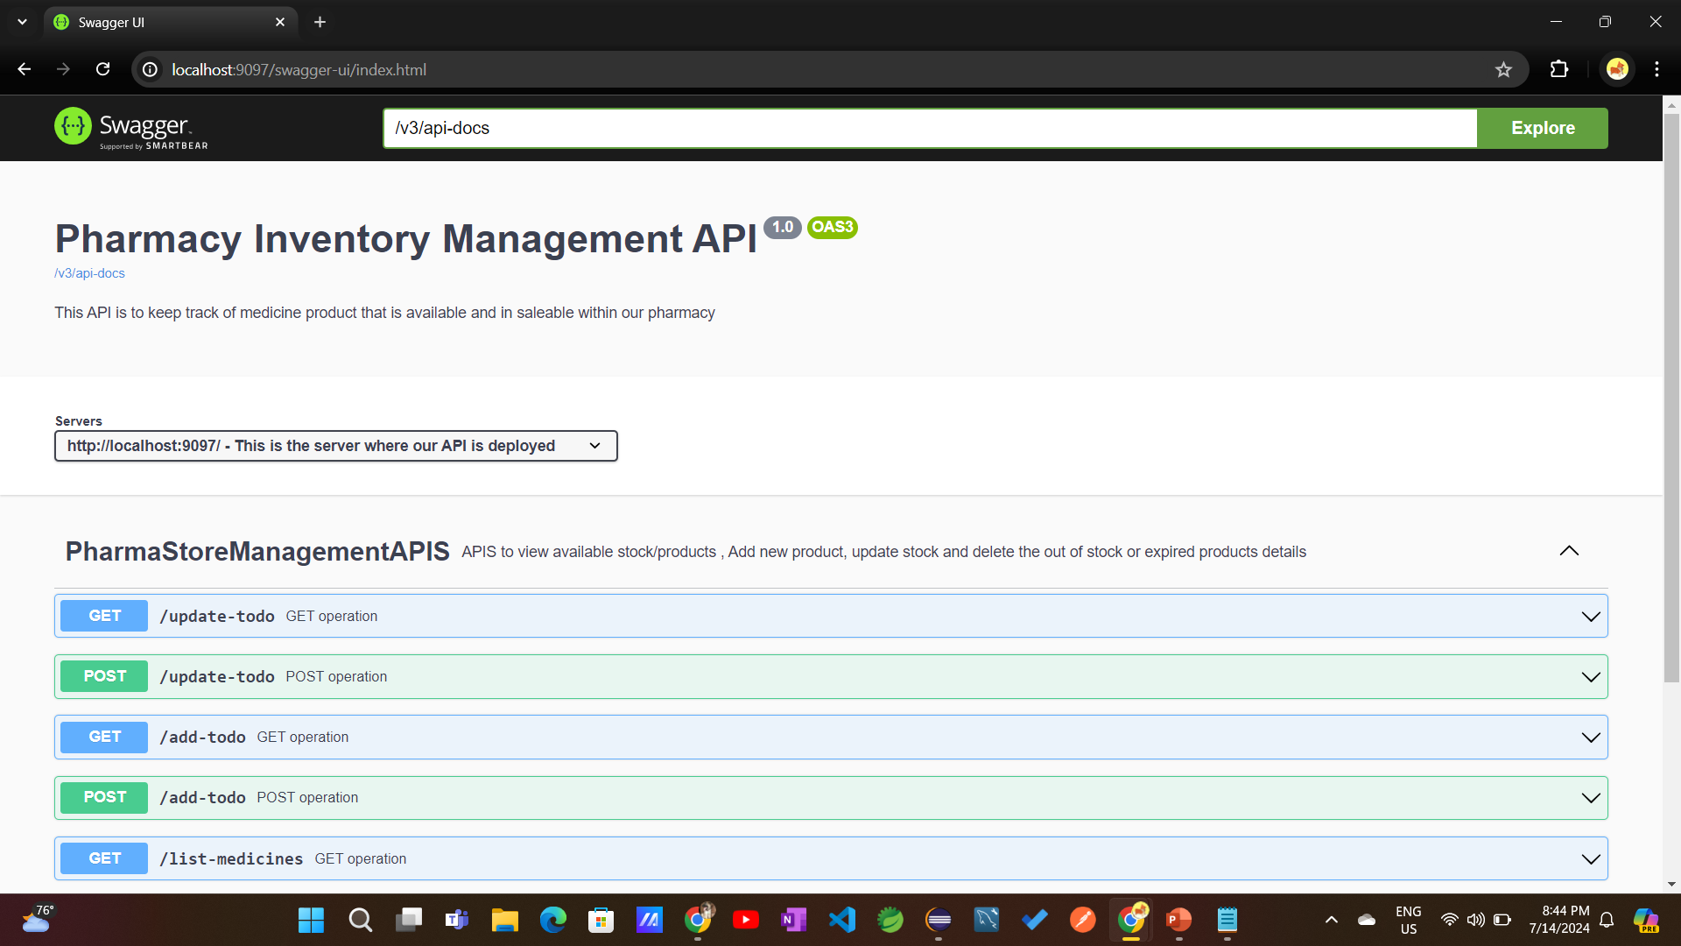
Swagger UI Documentation

Slide 12
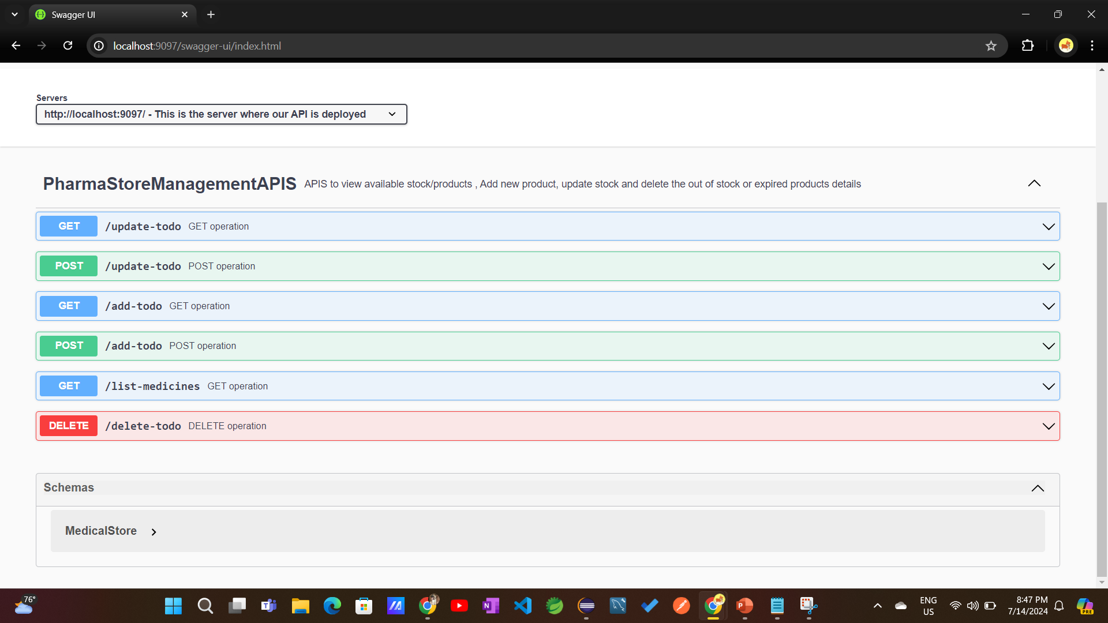
It shows all the request methods that can be used with a Resource.

Slide 13
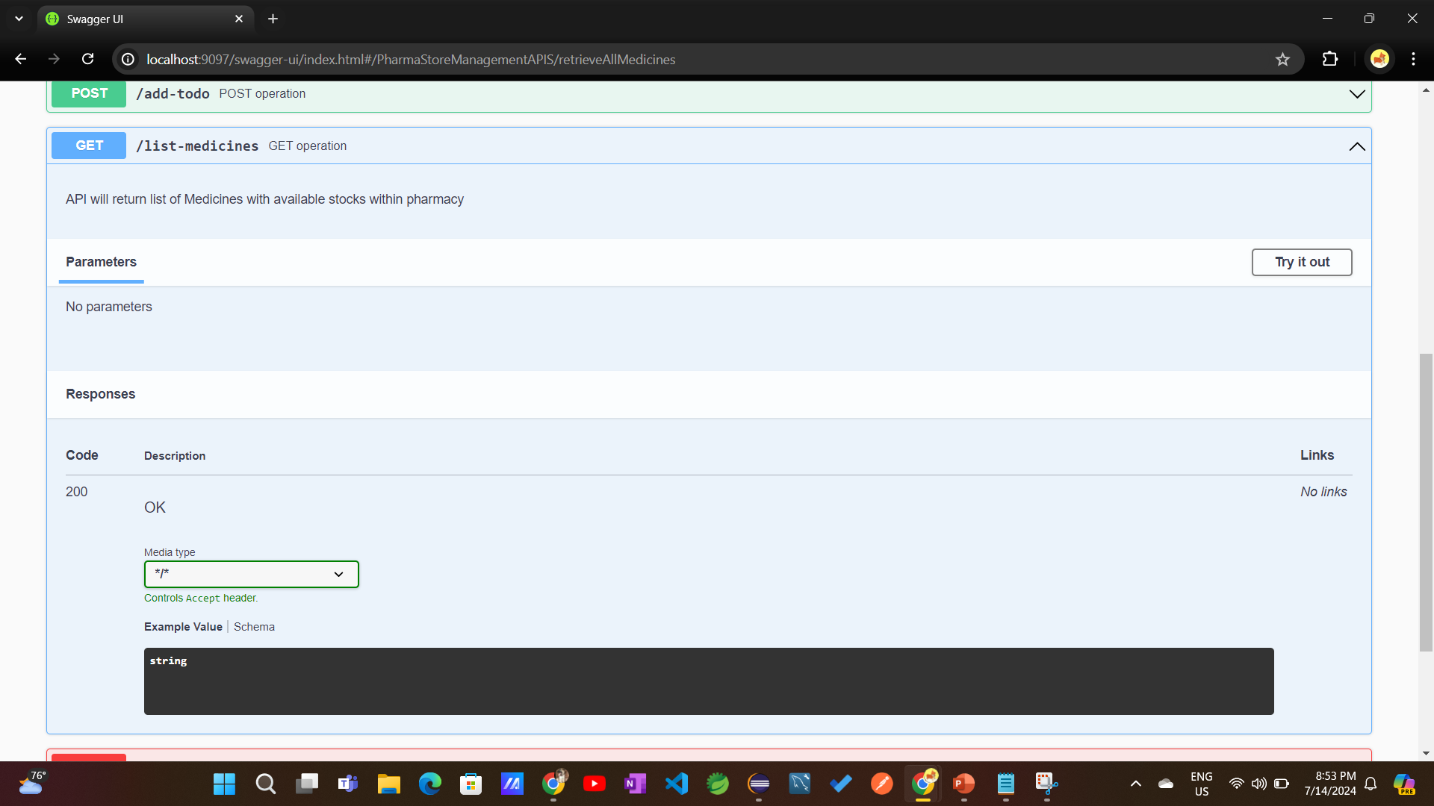
You can also see the details for a Specific Request Method.

Slide 14
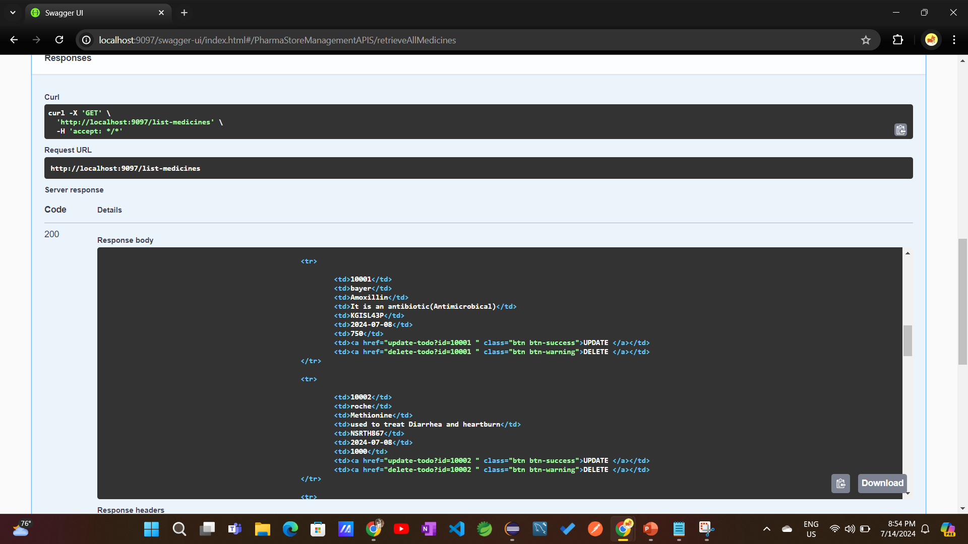
use the ‘Try it out’ button to execute a request and see the response.

Slide 15
Future Scope
customer can choose the medicines from category and place the order online option will be provide in future.
To build Website more User friendly and Secure and dynamic .

Slide 16
Thank You !

